Slide 1
Dynamic Scheduling in Distributed System using Ant Colony Optimization
Presented by,
Anu Mehndiratta
Dipali Suryawanshi
Sumitha P K

Slide 2
OUTLINE
Output Analysis
Output Generation
Compare output against hypothesis
Abnormal Case Explanation
Discussion
Summary and Conclusions
Recommendations for future studies

Slide 3
Output Analysis
We have run the program to generate the gridlets either random or manual. When we are generating the gridlets manually we have given few parameters shown in the below figure and analyze the results using different parameters
No of Resources | R1 | R2
MIPS Rating | 298 | 358
No. of Machine | 2 | 1
No of PE’s | 8 | 4
No of Gridlets (Task to be executed) | G1 | G2
Length | 1000 | 750
File_Size | 225 | 300
O/P file Size | 350 | 420
Deadline | 105 | 65
Gridlet ID | STATUS | ResourceID | Cost
0 | SUCCESS | 5 | 13.067
2 | SUCCESS | 5 | 7.55
Total |  |  | 20.122
Gridlet ID | STATUS | ResourceID | Cost
2 | SUCCESS | 9 | 6.2849
0 | SUCCESS | 5 | 10.06711
Total |  |  | 16.35201

Slide 4
No of Resources =4
Output FCFS & ACO
No of Resources | R1 | R2 | R3 | R4
MIPS Rating | 240 | 377 | 353 | 212
No. of Machine | 1 | 2 | 1 | 2
No of PE’s | 4 | 8 | 4 | 8
No of Gridlets (Task to be executed) | G1 | G2 | G3 | G4
Length | 1005 | 404 | 655 | 755
File_Size | 125 | 133 | 144 | 138
O/P file Size | 350 | 313 | 389 | 304
Deadline | 85 | 65 | 108 | 213
No of Gridlets (Task to be executed) | G1 | G2 | G3 | G4
Length | 1005 | 404 | 655 | 755
File_Size | 125 | 133 | 144 | 138
O/P file Size | 350 | 313 | 389 | 304
Deadline | 85 | 65 | 108 | 213
Gridlet ID | STATUS | ResourceID | Cost
6 | SUCCESS | 9 | 6.0079
2 | SUCCESS | 5 | 5.05
4 | SUCCESS | 13 | 5.56
0 | SUCCESS | 17 | 17.22
Total |  |  | 33.0162

Slide 5
No of Resources =5
Output FCFS & ACO
No of Resources | R1 | R2 | R3 | R4 | R5
MIPS Rating | 253 | 300 | 251 | 200 | `5
No. of Machine | 2 | 1 | 3 | 4 | 2
No of PE’s | 8 | 4 | 12 | 16 | 8
No of Gridlets (Task to be executed) | G1 | G2 | G3 |  | G4 | G5
Length | 1100 | 1200 | 1300 | 1000 |  | 900
File_Size | 135 | 125 | 145 | 150 |  | 150
O/P file Size | 300 | 200 | 255 | 300 |  | 375
Deadline | 100 | 150 | 120 | 140 |  | 125
Gridlet ID | STATUS | ResourceID | Cost
0 | SUCCESS | 5 | 16.04348
2 | SUCCESS | 17 | 18
4 | SUCCESS | 5 | 15.41502
6 | SUCCESS | 21 | 12.52381
8 | SUCCESS | 9 | 9
Total |  |  | 70.98231
Gridlet ID | STATUS | ResourceID | Cost
2 | SUCCESS | 13 | 17.34263
6 | SUCCESS | 5 | 14.85771
0 | SUCCESS | 17 | 16.5
8 | SUCCESS | 9 | 9
4 | SUCCESS | 21 | 15.38095
Total |  |  | 73.08

Slide 6
Output Generation
In order to generate the output we ran the implemented algorithm for FCFS and Ant colony. We have calculated total cost by adding cost of each job. And compared total cost for both algorithm.
First we have created the grid resources and then no of jobs called gridlets and then we have given the criteria to user to choose the type of scheduling algorithm to allocate these gridlets to available resources. In our program we are using only FCFS and ACO but this can be extended to other scheduling algorithm. After the selection of scheduling algorithm program will generate the output.

Slide 7
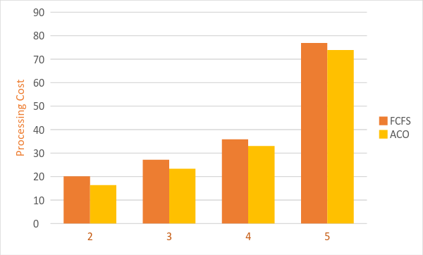
Compare output against hypothesis
From the graph we can see the Processing Cost using ACO algorithm is lesser than FCFS.
Processing Cost = Cost per sec * CPU Execution Time.
Plot of No. of Grid Resources vs Processing Cost

Slide 8
Abnormal Case Explanation
In few cases where number of resources and no of task to be executed are less we are not able to see significant difference in the performance
In some situation where parameters values are not consistent in such cases this algorithm may not give correct results.

Slide 9
Discussion
The main aim of our project was to minimize makespan and maximize CPU utilization.
Jobs are assigned to resources in such a way that total completion time of task is minimized or in other words makespan is minimized.
We have compared FCFS and Ant colony algorithm for equal no of jobs and resources, results shows that tasks are almost equally divided in no of resources so that each resource is utilized properly where as in FCFS same resources are used for different task results in some of resources may left as unused.
In Ant colony algorithm, optimal tour of resources is selected by multiple times iterating over given resources.
As Ant colony algorithm finds its solution by considering all possibilities, end result is most optimized one.

Slide 10
Summary and Conclusions
Scheduling in distributed systems has a significant role in overall system performance and throughput.
Simulation results demonstrate that Ant Colony Algorithm based scheduling algorithm outperforms FCFS (First Come First Serve) based scheduling.
The traditional methods try to reduce the overall response time by giving an optimized schedule. But they fail to produce a load balanced schedule.
The proposed method also helps in load balancing as the grid resource with minimum load is attracted by most of the ants.
Thus, it is convincingly proved that task scheduling is best solved by heuristic approach.

Slide 11
Recommendations for future studies
The algorithm can be extended considering the constraints of resources which is to be considered during real- world applications.
It can be extend to select the type of scheduling automatically based on the no of task to be executed and available resources to give the better results.
The ant colony approach could also be included in the list of future reliable and useful optimization tools in various fields such as chemical engineering, quadratic assignment problems, network routing problems etc.

Slide 12
Thank you…!

